Slide 1

Haywood County Schools Exceptional Children’s Preschool Program
Eunice Ledford - EC Preschool Coordinator

Slide 2
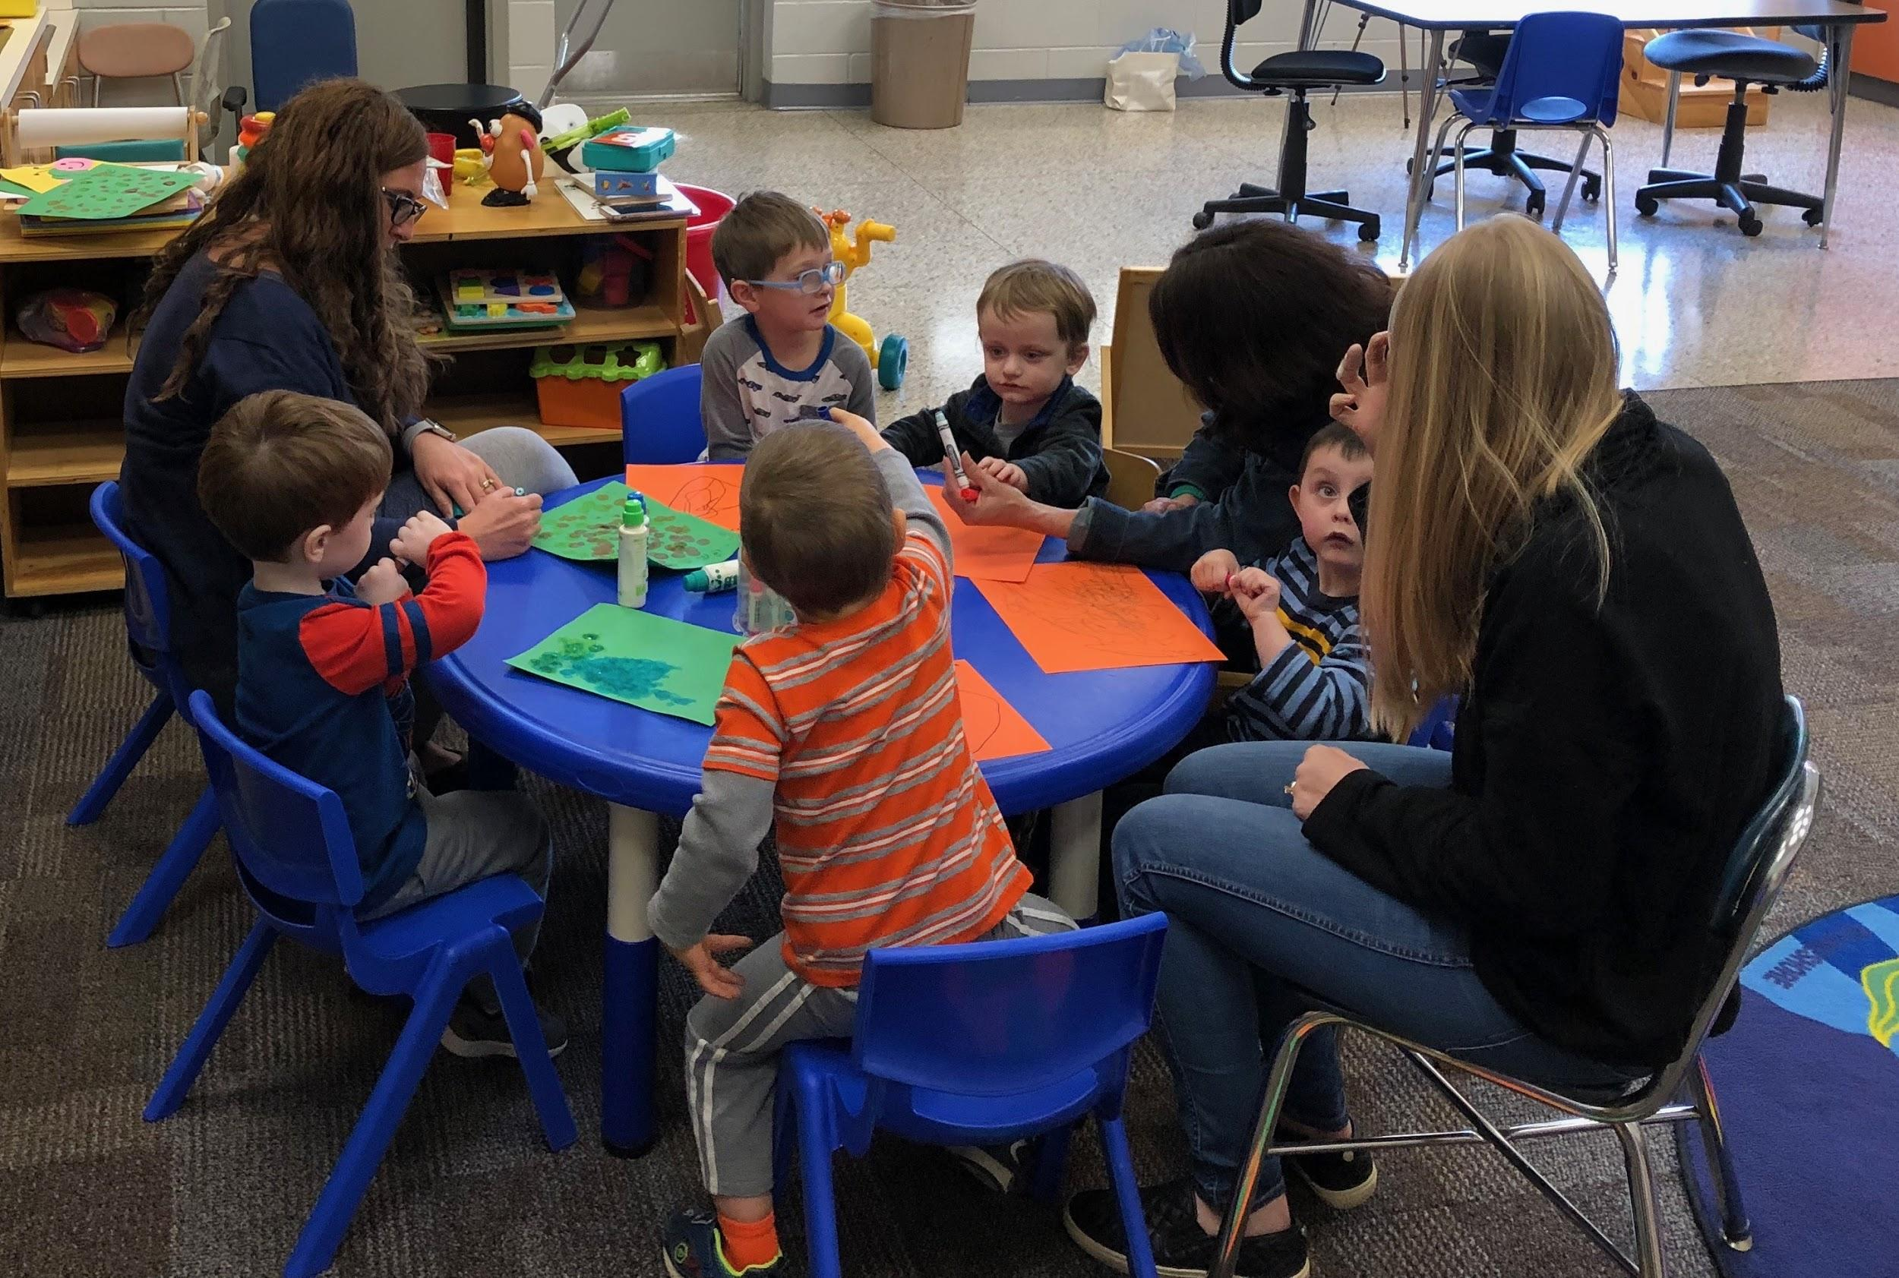
HCS Exceptional Children’s Preschool Program provides special education services for children ages 3-5 with a variety of special needs.
These services include:
Special Instruction
Speech /Language Therapy
Occupational Therapy
Physical Therapy

Slide 3
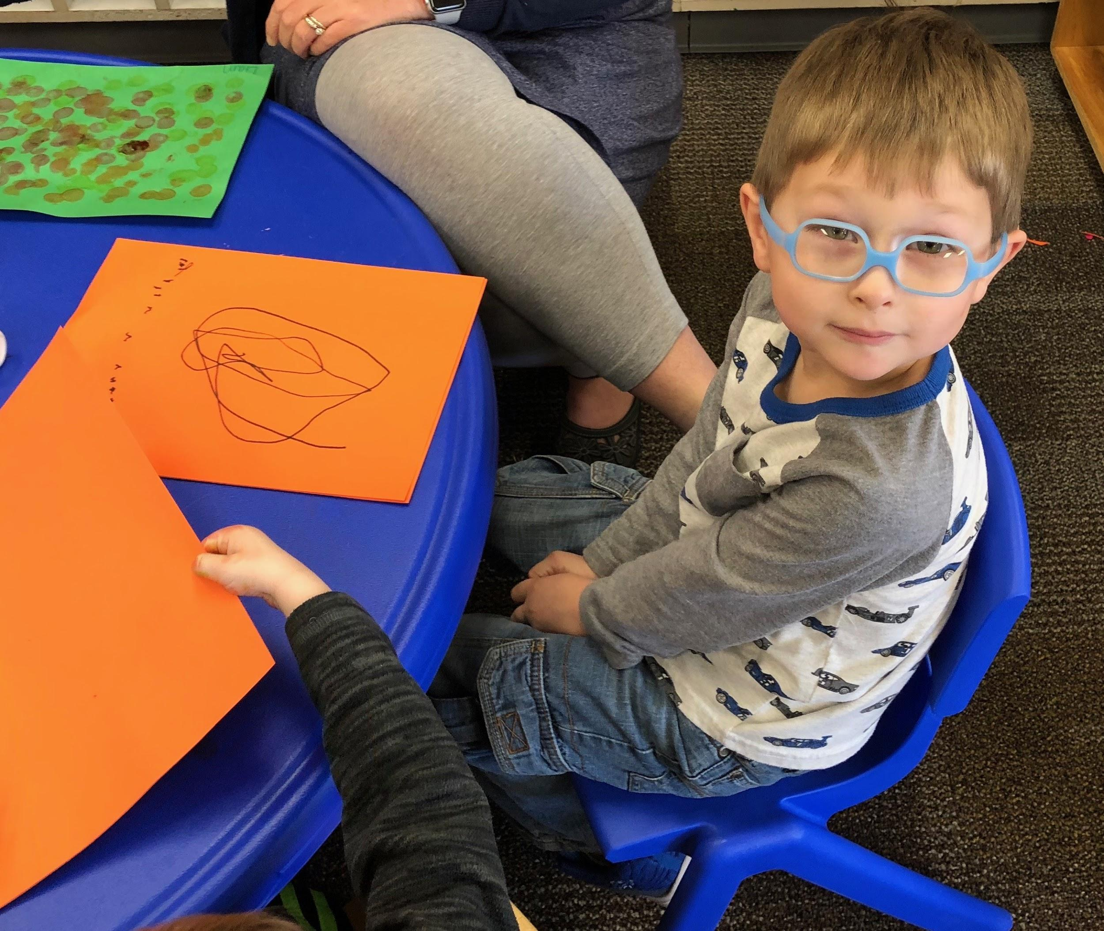
Child Find
CDSA Infant Toddler Program
Private Preschool/Childcare Programs
HeadStart
Parents
Department of Social and Human Services
Private Therapy Providers
Physicians

Slide 4
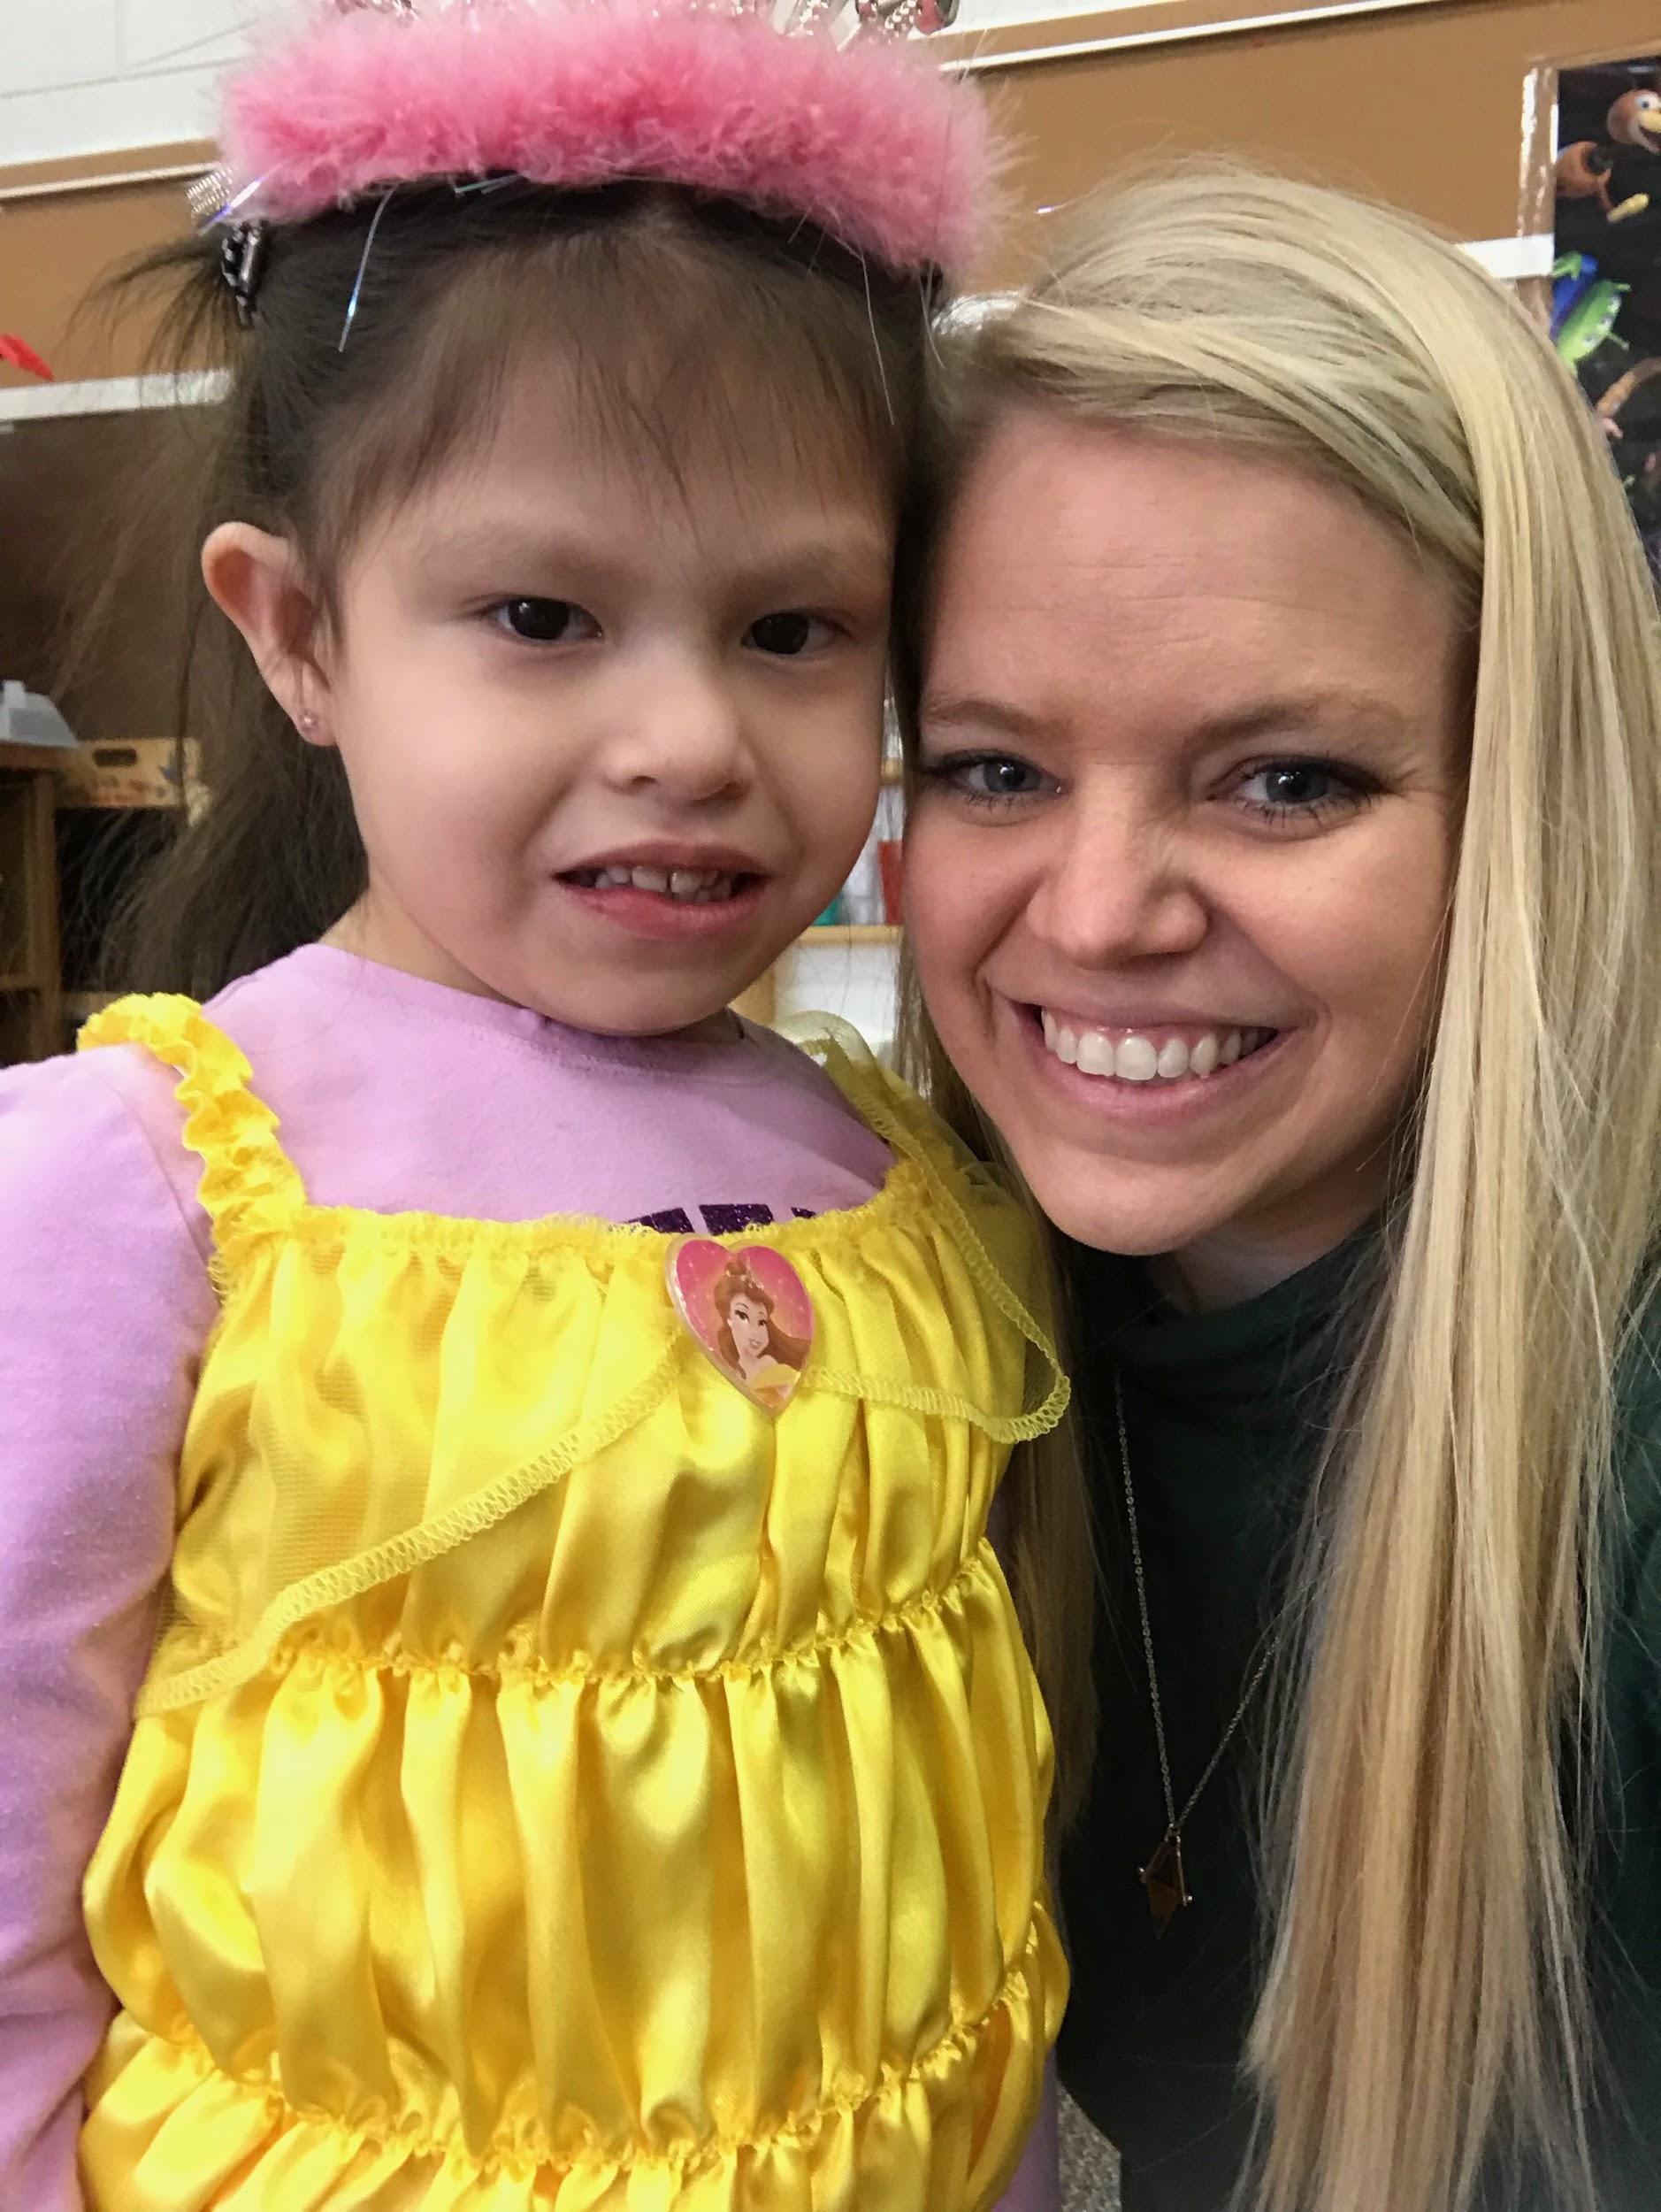
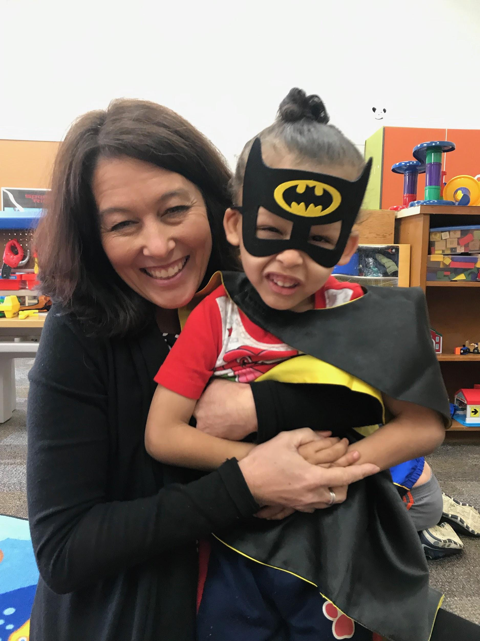
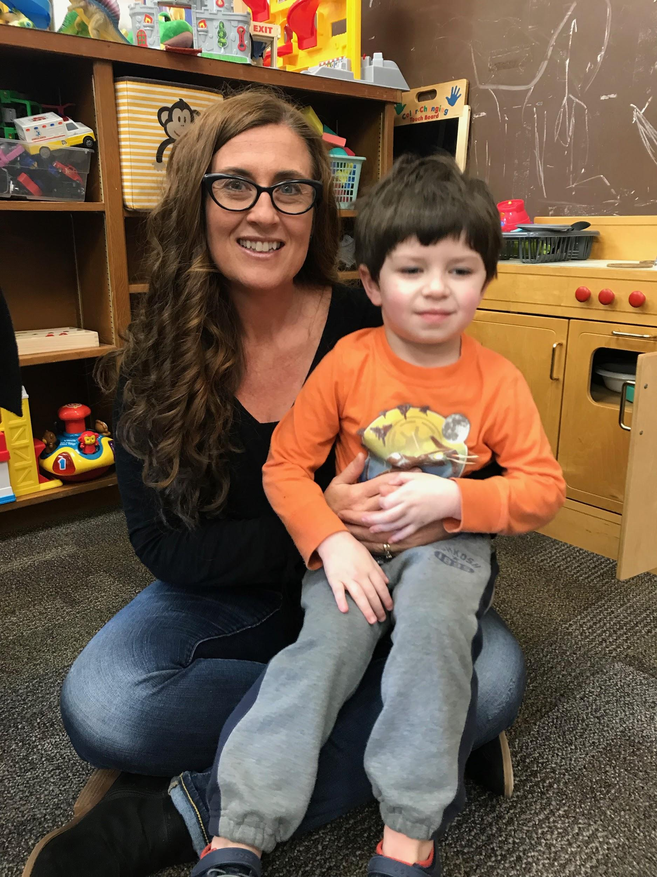
Referral and Evaluation Process
Notification
Screening
Screening indicates whether or not there is a need for further evaluations
Initial referral meeting to discuss referral concerns
Evaluation completed (if recommended)
Evaluation results
Determine eligibility and if eligible under NC eligibility guidelines develop an Individualized Education Program

Slide 5

Evaluations
Speech Language Evaluation
  Receptive and Expressive Language skills
  Articulation/Sound Development
  Pragmatics/Social Skills
  Voice/Resonance/Fluency
Transdisciplinary Play-based Assessment
  Sensory Motor Development
  Cognitive Development
  Emotional and Social Development
  Conceptual Development
  Communication Development
Comprehensive Evaluation
  Psychological - including cognitive and social/emotional measures
  Educational skills
  Speech/Language skills
  Motor skills
Autism Evaluation (One or more)
  Autism Diagnostic Observation System-2nd Edition
  Child Autism Rating Scale- 2nd Edition
  Autism Symptoms Rating Scale

Slide 6
North Carolina Eligibility Guidelines
Speech/Language Impairment Eligibility Criteria:
  Language: Testing indicates that the child has difficulty understanding and/or expressing ideas and/or concepts to such a degree that it interferes with the child's social-educational progress.
  Articulation: Two or more speech sounds errors/ and or patterns of sound errors not expected at the child's age or developmental level.
Developmental Delay Eligibility Criteria:
  Delayed/Atypical development in one or more of the following areas: physical, cognitive, communication social/emotional or adaptive:
    25% delay in two or more areas or 30% delay in one area.
Autism
  Impairment in the following areas: (must demonstrate impairment of at least 3 of 4)
  Communication, Social Interaction, Sensory Responses/Experiences, restricted, repetitive or stereotypical patterns of behavior, interests, and or activities
* Educational vs Medical Model
Notes:
Up until age three special services are focused on family and medical interventions. Once the child transitions into school age services, goals change to an educational model with the focus on the child being successful in their educational setting.

Slide 7
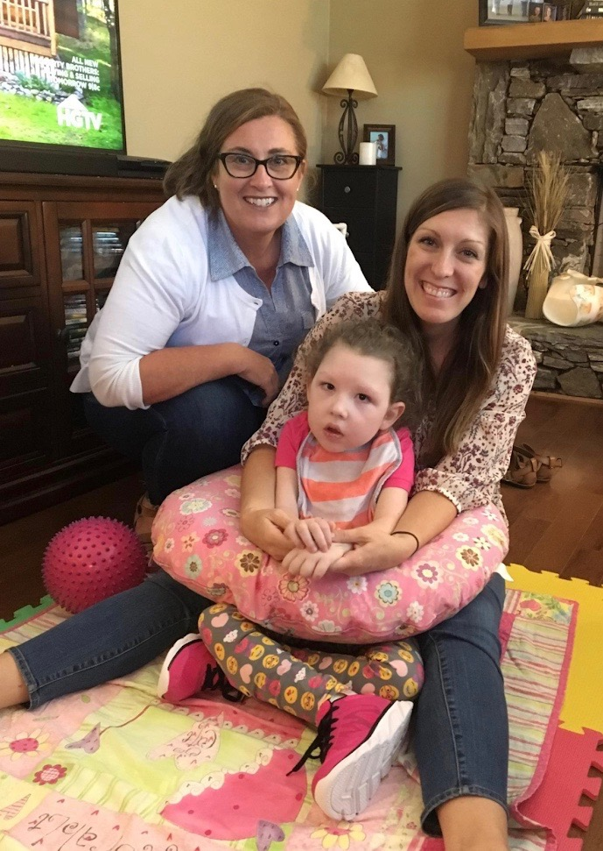
Individualized Education Program (IEP)
Develop IEP with present levels of performance and goals
Required IEP team members
  Parent (#1 member)
  LEA (Local Education Agency)
  Regular Education Teacher
  Special Education Teacher
  Related Service Provider (ST, PT, OT)

Slide 8
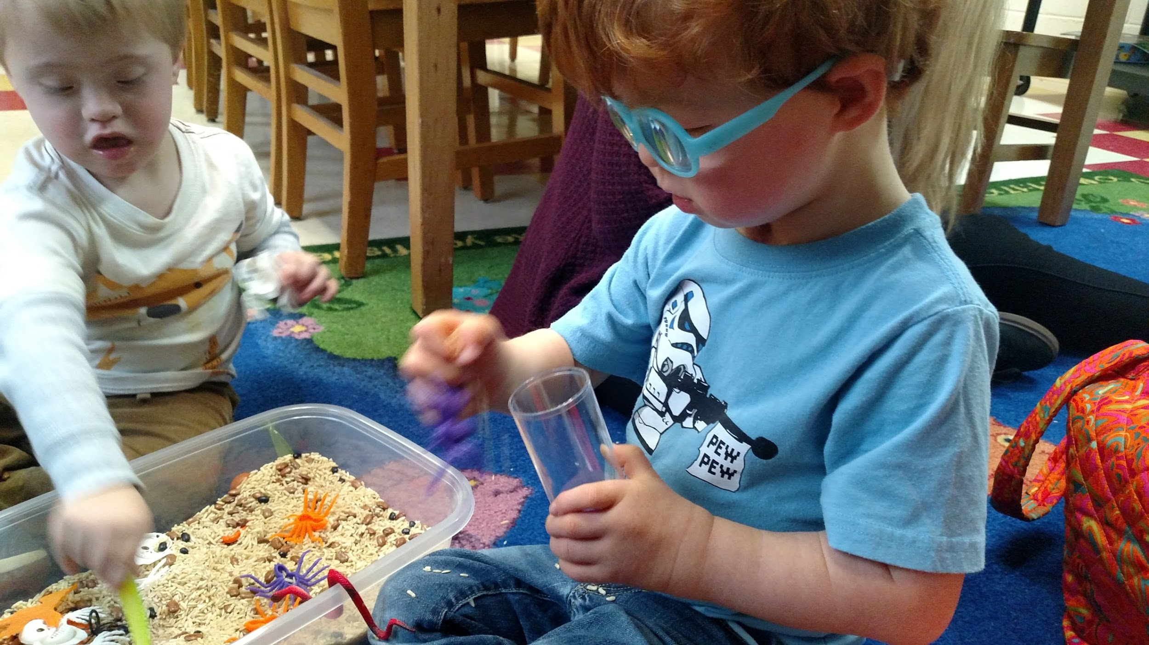
Location of Services
HCS currently serves 1302 students with special needs
HCS Preschool currently serves 106 students with special needs
Private Preschool/Child Care
Head Start Program
NCPK Classrooms
Preschool Office Playgroup

Slide 9
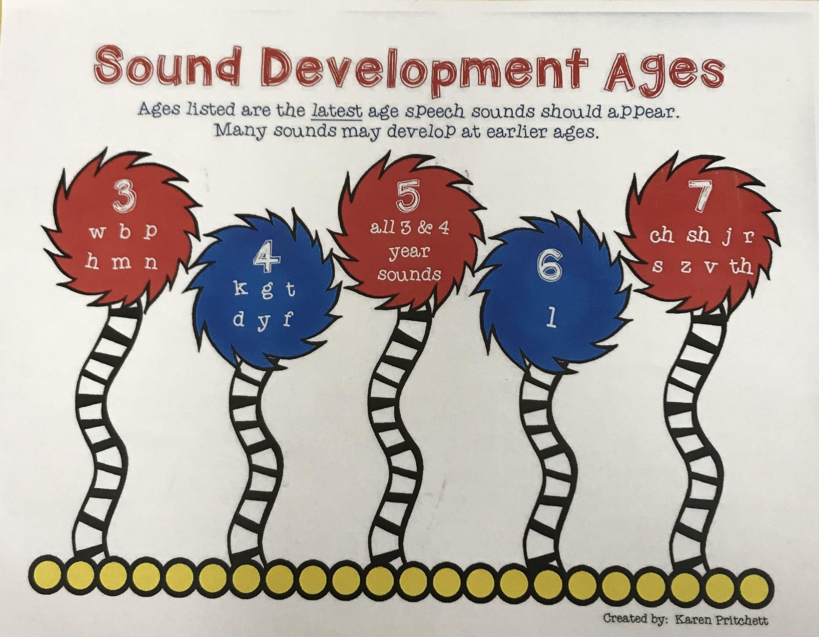

Slide 10
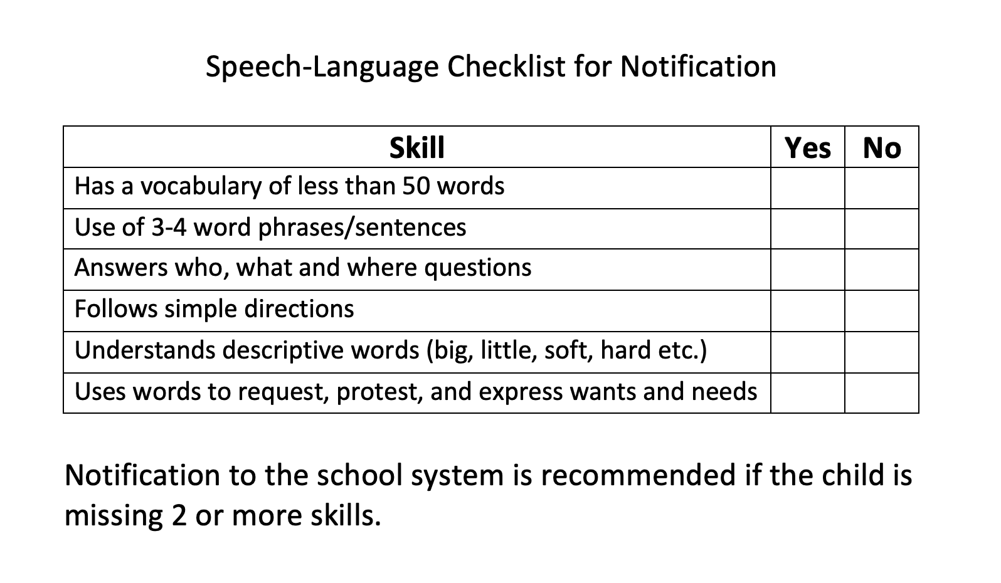

Slide 11
